Slide 1
Measuring Electricity

Slide 2
Electrical Current
Day to Day products that we all benefit from that rely on the movement of electrons
Movement of electrons between atoms – Electrical Current

Slide 3
Amperage
Amperes – flow of electrons is measured in units (amps)
Amount of electrical current that exists when a number of electrons, having one coulomb of charge, move past a given point in one second
Coulomb – charge carried by 6.25x10^18 electrons
Notes:
6,250,000,000,000,000,000

Slide 4
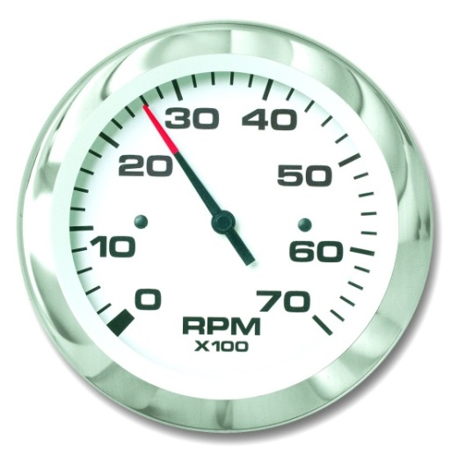
Amperage
The amount of electrical current flowing past a point in a circuit.
Amperage is measured with an ammeter.
Instrument used to indicate how many amps of current are flowing in an electrical circuit

Slide 5
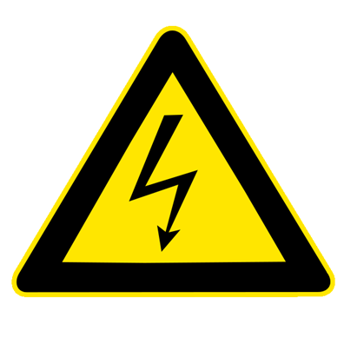
Voltage
The pressure in a circuit that causes the electrons or current to flow.
Electromotive force (EMF)
A volt is the unit by which electrical pressure
Force required to push one ampere of electrical current through a conductor with a resistance of one ohm
Voltmeter
E or V symbols for voltage

Slide 6
Voltage
Measured in Volts
The difference in the electrostatic charge that exists between two points
This is the imbalance in the electrostatic charge that causes electrons to flow from one point to the next

Slide 7
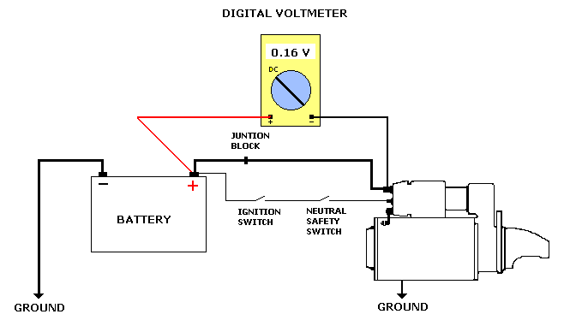
Voltage Drop
When electricity must be carried a long distance through wires, there will be a decrease in voltage
Occurs due to resistance in the conductors.

Slide 8
Watts or wattage
Measure of electrical power
Electrical power is work being done by current(amperage) under pressure(voltage) in getting the electrons through the resistance of wires and machines back to the generator.
Units of 1,000 watts are called kilowatts.
The relationship between watts(P), amps(I), and volts(E) is P=I x E.

Slide 9
Resistance
Measured in units called ohms.
One ohm – amount of electrical resistance that exists in an electrical circuit when one amp of current is flowing with one volt being applied to the circuit
Describes the forces that oppose the flow of electron current in a conductor
No way to make conductors that don’t have some resistance

Slide 10
Resistance
tendency of the wire to resist the flow of electrons or current through the wire.
Within a circuit, electrical resistance is dependent upon size, length, and the material of the conductor.
Smaller diameter wire = more resistance than larger.
longer the wire = more resistance.

Slide 11
Resistance
Finally, silver, copper, and aluminum offer the least resistance to the flow of an electrical current as compared to other metals.
Resistance is measured in ohms.
The relationship of ohms (R), volts (E), and amps (I) is E=I x R.

Slide 12
Ohms Law
Mr. Georg Ohm
Mathematician and Physicist
Defined the relationship between power, voltage, current and resistance
Apply to AC/DC
Foundation for electronics and electricity
Established in the late 1820s
Notes:
Formulas are very easy to learn, used extensively by electricians
Without a thorough understanding of “ohms law” an electrician would either design or troubleshoot even the simplest of electronic or electrical circuits
Established – if voltage was applied to a resistance then “current would flow and then power would be consumed”
- (Power consumption through resistance)

Slide 13
Classic everyday Examples
Base board heaters
Electric frying pans
Toasters
Electric light bulbs
Notes:
Heater – consumes power for warmth
Frying pan – consumes power producing heat for general cooking
Toaster – consumes power for cooking toast
Light bulb – consumes power producing heat and more important light
Further example – electric hot water system

Slide 14
Current directly proportional to voltage
Voltage increased by %, current increased by the same
Current inversely proportional to resistance
Increase resistance, decrease current
Decrease resistance, increase current
Resistance cannot be changed by changing voltage or current

Slide 15
Water Analogy
Voltage – Water Pressure
Current – Flow rate
Resistance – hose size
Pressurized tank connected to a hose that we are using to water the garden

Slide 16
Current = Voltage / Resistance (I = V/r)
What happens when you increase the pressure in the tank?
Makes more water come out of the hose
Increasing voltage will make more current flow
What happens when you increase the diameter of the hose and all of the fittings to the tank?
Makes more water come out of the hose
Decreasing the resistance in an electrical system, increases current flow

Slide 17
Power = Voltage x Current (P = VI)
Point hose at a water wheel
Increase power generated in 2 ways
Increase the pressure of the water
Increase the flow rate
Increasing either current or voltage will result in higher power

Slide 18
Current = Voltage/resistance (I = V/r)
Voltage = 12 volts
Resistance = 6 ohms
Current = 2 amps
Voltage = 240 volts
Current = 24 amps
Resistance = 10 ohms

Slide 19
Power = Voltage x Current (P = VI)
6 volt light bulb hooked to a 6 volt battery power output 100 watts
P = 100 watts
V = 6 volts
Rearrange Equation (I = P/V)
100 watts / 6 volts = 16.66 amps
12 volt battery and a 12 volt battery to get 100 watts of power
100 watts / 12 volts = 8.33 amps

Slide 20
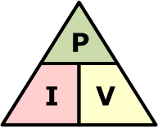
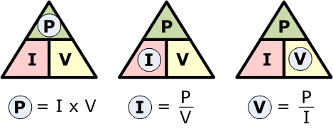

Slide 21
What is an equation for power in terms of resistance and current?
Current = Voltage / resistance (I = V/r)
- rephrased as -
Voltage = Current x resistance (V = Ir)
- Now we can substitute the equation for V into the equation -
Power = Voltage x Current
- Substitute for V -
Power = Current x resistance x Current
(P = IrI), (P = $I^{2}$r)
Resistance = Voltage / Current (r = V/i)

Slide 22
Voltage = Current x resistance (V = Ir)
Amps = 6
Ohms = 12
Voltage = 72
Amps = 3
Ohms = 6
Voltage = 18

Slide 23
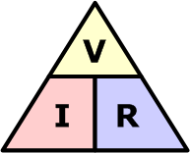
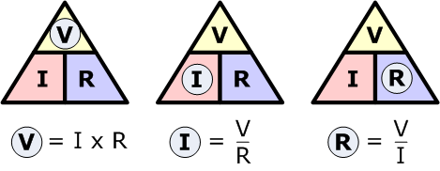

Slide 24
Resistance = Voltage / Current (r = V/i)
Voltage = 12
Amps = 2
Ohms = 6
Voltage 32
Amps = 8
Ohms = 4

Slide 25
Ohms Law Tutorial
http://www.techievideos.com/videos/899/Electronics-tutorial-Ohm-s-Law/

